Slide 1

Big Mountain Ski Resort
Report on Ticket Prices and Facilities

Slide 2

Problem Identification
How can Big Mountain capitalize on its facilities to increase revenue for the resort?
Can costs be cut without undermining ticket prices?
Can a higher ticket price be supported?
Can the pricing structure be restructured, perhaps based on facility usage?

Slide 3
Key Findings and Recommendations
Business Scenarios:
Permanently close down up to 10 of the least used runs. This doesn’t impact any other resort statistics.
Increase the vertical drop by adding a run to a point 150 feet lower down but requiring the installation of an additional chair lift to bring skiers back up, without additional snow making coverage.
Same as number 2, but add 2 acres of snow making cover.
Increase the longest run by 0.2 mile to boast 3.5 miles length, requiring an additional snow making coverage of 4 acres.

Slide 4
Key Findings and Recommendations
Recommendation:
Increase the vertical drop by adding a run to a point 150 feet lower down but requiring the installation of an additional chair lift to bring skiers back up, without additional snow making coverage.

Slide 5
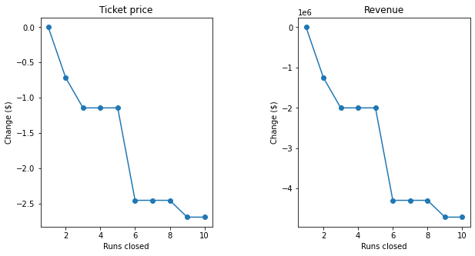
Modeling, Results & Analysis
Permanently close down up to 10 of the least used runs. This doesn’t impact any other resort statistics.
Closing down 10 runs would lead to a decrease in ticket prices and revenue.
How number of runs affects ticket prices and revenue:

Slide 6

Modeling, Results & Analysis
Increase the vertical drop by adding a run to a point 150 feet lower down but requiring the installation of an additional chair lift to bring skiers back up, without additional snow making coverage.
This scenario increases support for ticket price by $9.02. Over the season, this could be expected to amount to $15,791,667.

Slide 7

Modeling, Results & Analysis
Same as number 2, but add 2 acres of snow making cover.
This scenario increases support for ticket price by $11.26 Over the season, this could be expected to amount to $19,708,333
Such a small increase in the snow making area makes no difference!

Slide 8

Modeling, Results & Analysis
Increase the longest run by 0.2 mile to boast 3.5 miles length, requiring an additional snow making coverage of 4 acres.
No difference whatsoever. Although the longest run feature was used in the linear model, the random forest model (the one we chose because of its better performance) only has longest run way down in the feature importance list.

Slide 9
Summary and Conclusion
Increase the vertical drop by adding a run to a point 150 feet lower down but requiring the installation of an additional chair lift to bring skiers back up, without additional snow making coverage.
Increases revenue
Least upgrades to existing facilities
Costs can be recouped quickly (w/in 1 year)

